Slide 1
LAB 6 - Scale & Load Balance your Architecture
Made for Professor Lanham A. by Amrit Singh

Slide 2
AGENDA
Accessing the AWS management console
Task 1 : Create an AMI for Auto Scaling
Task 2 : Create a Load Balancer
Task 3 : Create a Launch Configuration and an Auto Scaling Group
Task 4 : Verify that Load Balancing is Working
Task 5 : Test Auto Scaling
Task 6 : Terminate Web Server 1

Slide 3
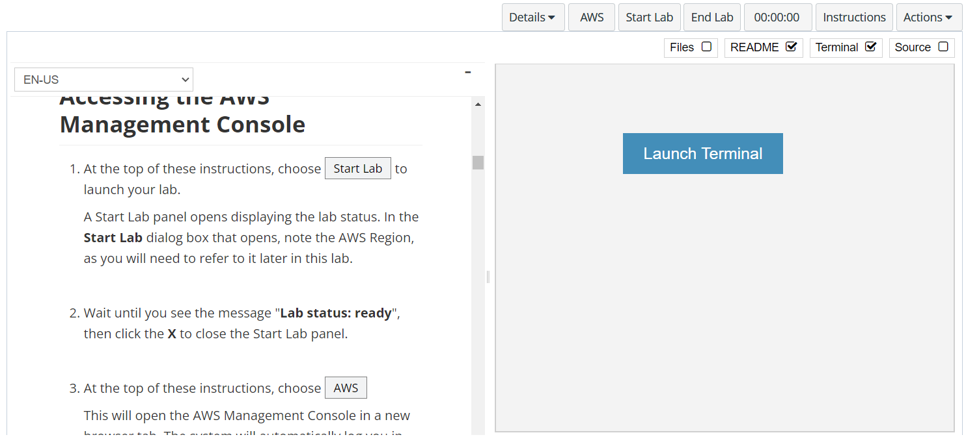
In aws labs click on start lab

Slide 4
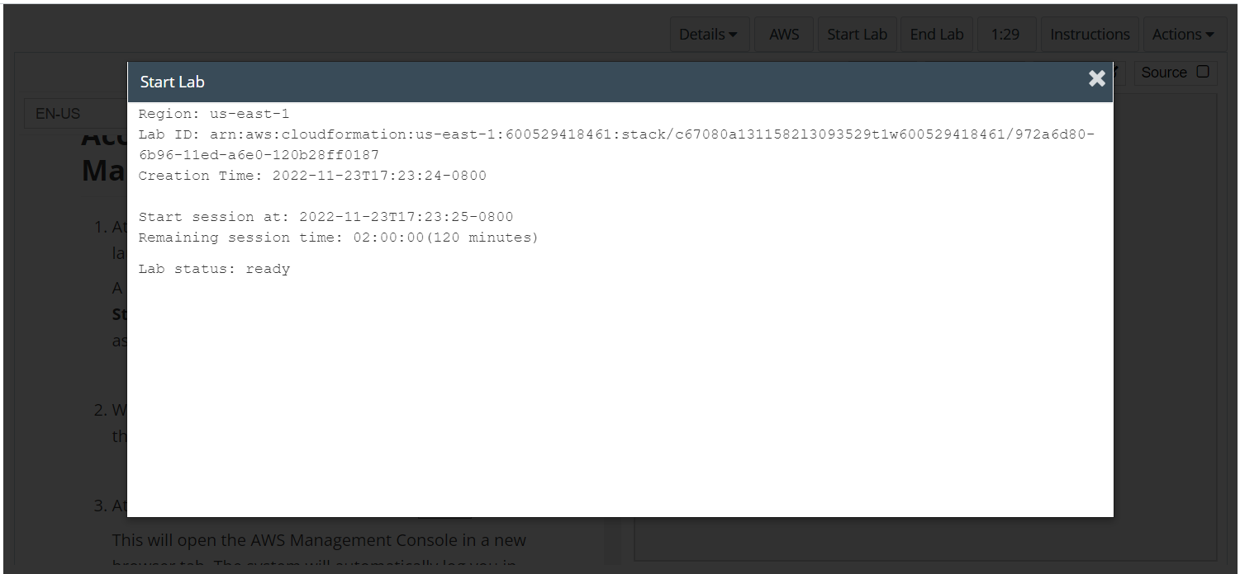
Wait to see lab ready status in the window then press x and click on aws to launch console

Slide 5
Task 1 : Create an AMI for Auto Scaling

Slide 6
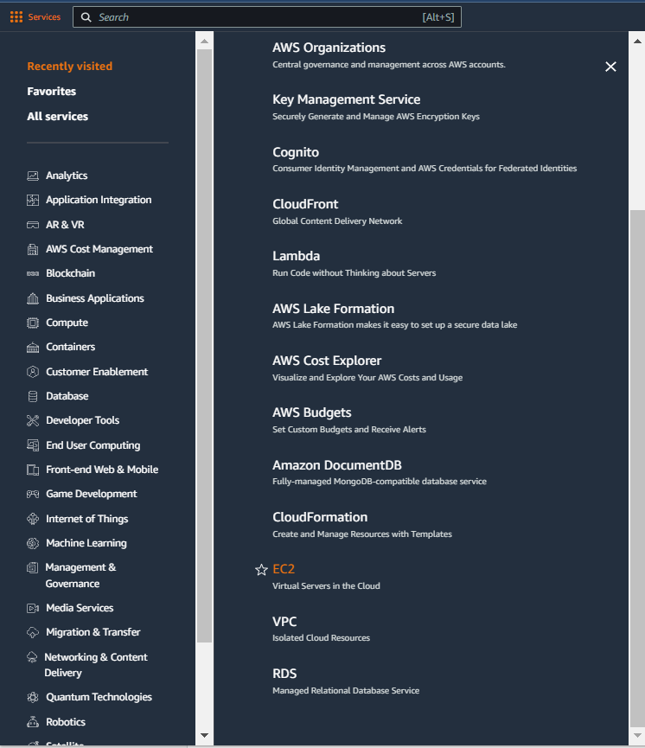
Select services and then click on ec2 button
Click on the Services button
Click on the EC2 button

Slide 7
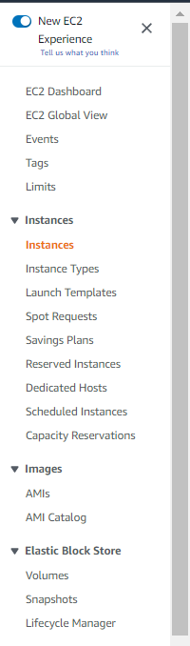
CHOOSE instances IN THE NAVIGATION PANE
Click on the Instances in the left pane

Slide 8
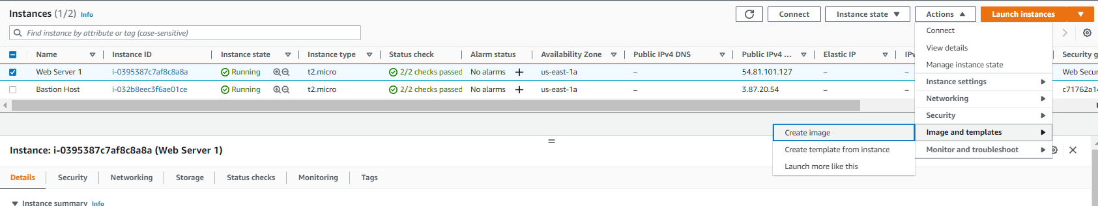
Wait for the instances to pass the checks and then select web server 1 > actions > image and template > create image

Slide 9
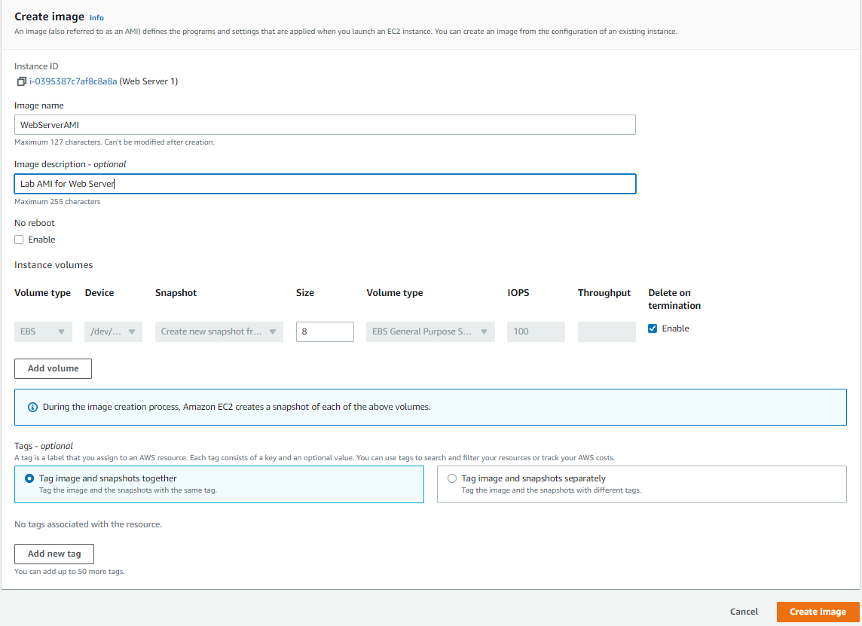
Configure the details regarding the images as shown and then click create image

Slide 10
Task 2: Create a Load Balancer

Slide 11
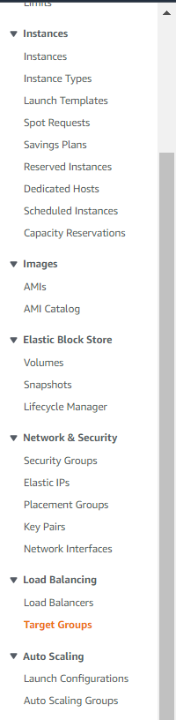
CHOOSE target groups IN THE NAVIGATION PANE
Click on the target groups in the left pane

Slide 12
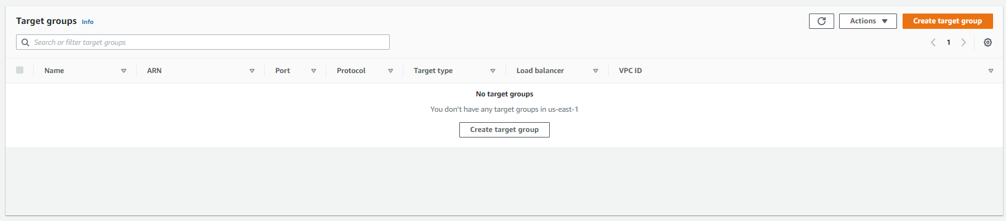
Click on create target group

Slide 13
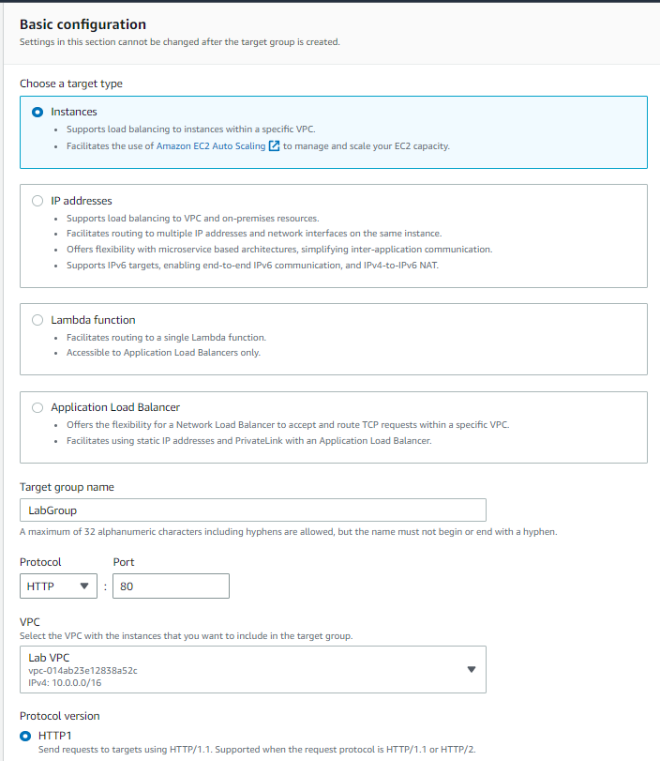
Select instances as target type, select lab vpc as vpc and then click next and then review the settings and click create target group

Slide 14
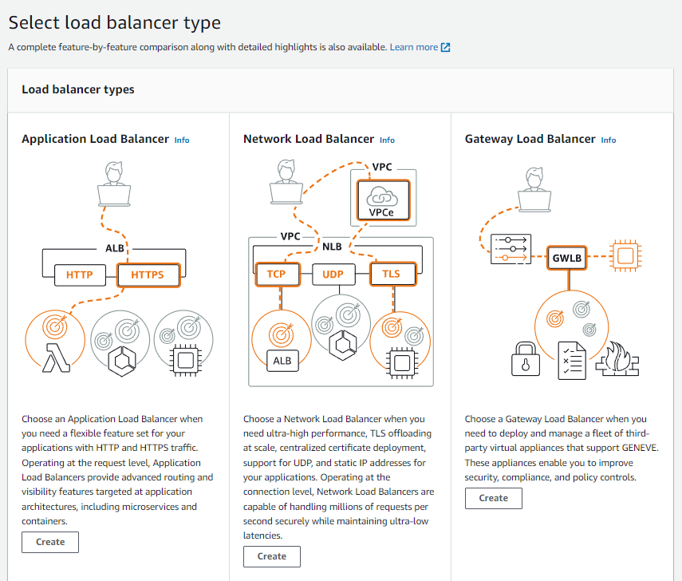
Click on load balancers in the navigation pane and then click on create load balancer, choose create under APPLICATION LOAD BALANCER

Slide 15
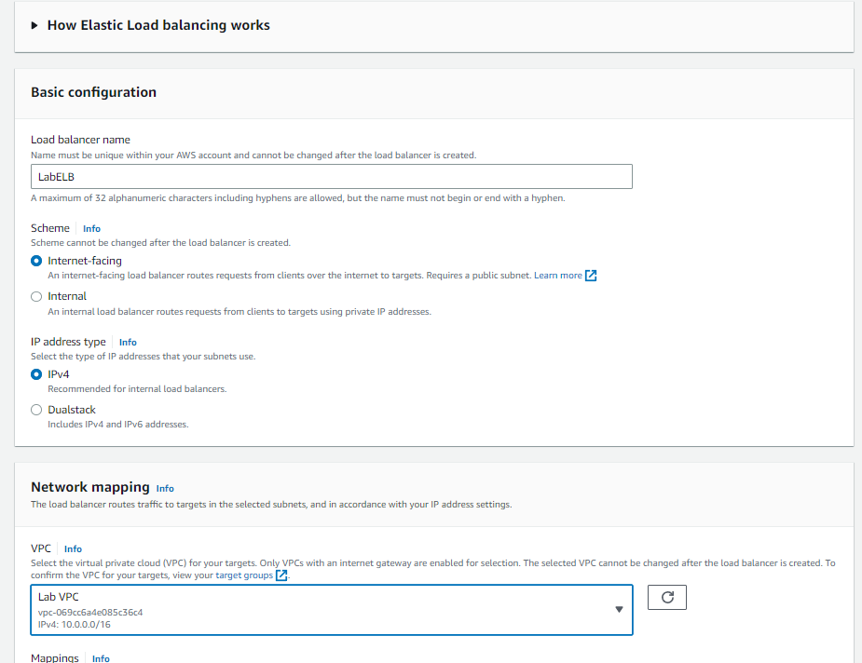
Configure labELb as the load balancer name as shown and vpc as lab vpc

Slide 16
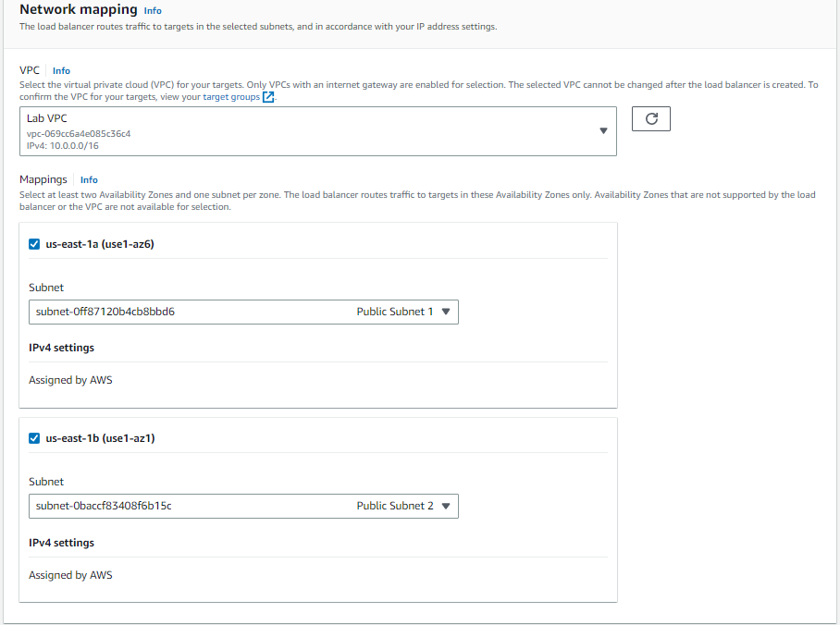
Add mappings as shown

Slide 17
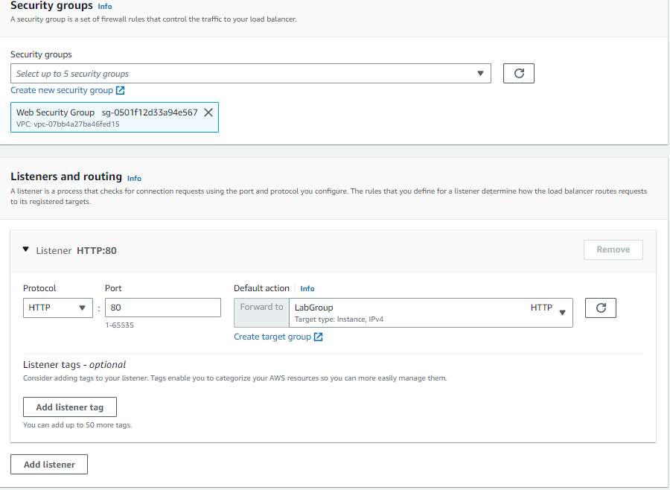
Under security group choose web security group and under listener forward to labgroup, then select create load balancer

Slide 18
Task 3: Create a Launch Configuration and an Auto Scaling Group

Slide 19
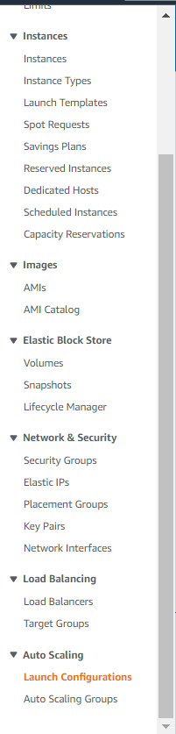
CHOOSE Launch configuration IN THE NAVIGATION PANE
Click on the Launch configuration in the left pane

Slide 20
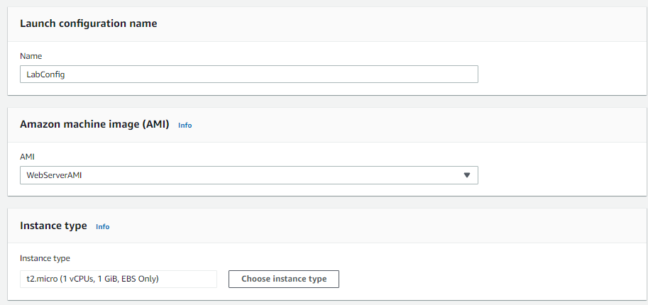
Update the config as shown, select web server ami

Slide 21
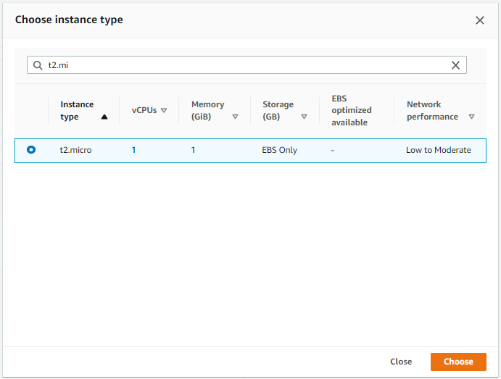
Choose t2.micro instance type

Slide 22
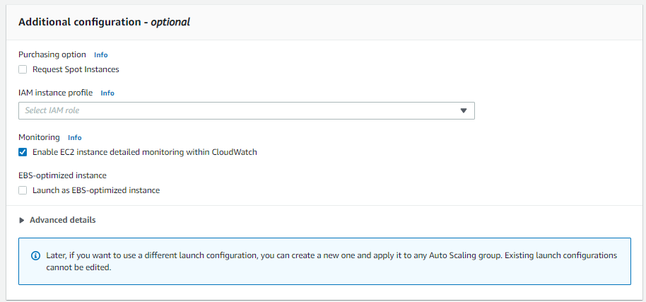
Enable ec2 instance detailed monitoring under additional configuration

Slide 23
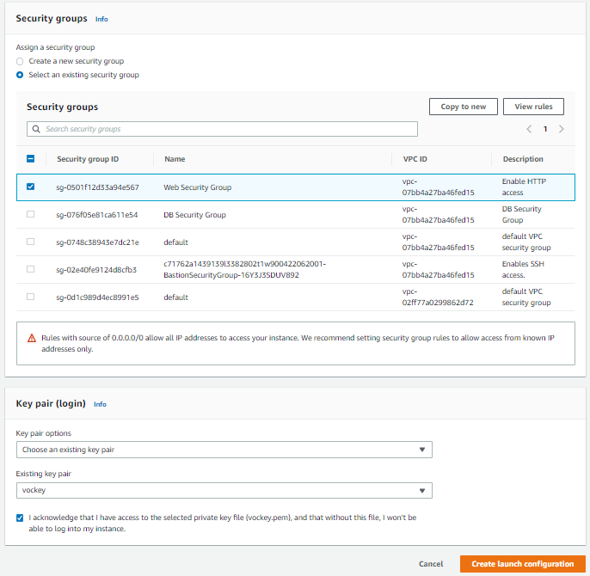
Select web security group and key pair login as vockey and click create launch configuration

Slide 24
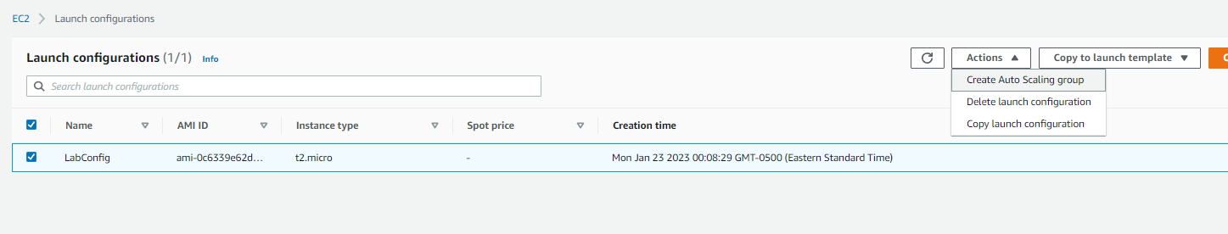
Choose labconfig and then click actions > create auto scaling group

Slide 25
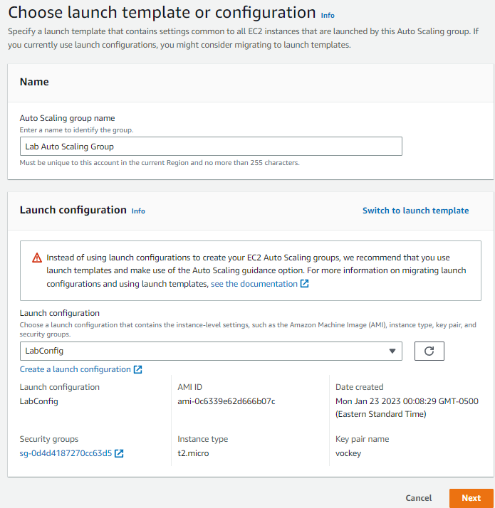
Set name as lab auto scaling group and then click next

Slide 26
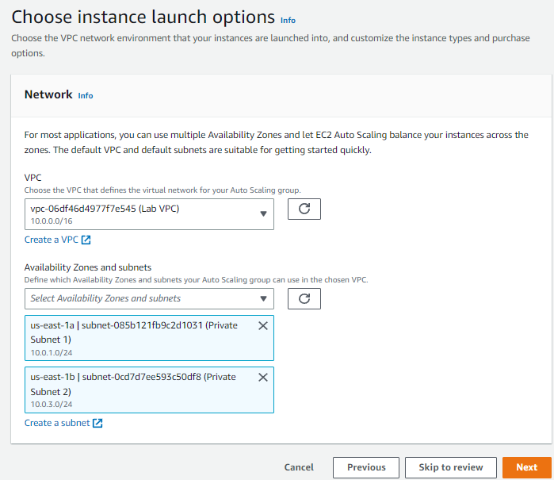
Choose the lab vpc and then select private subnet 1 and private subnet 2 and click nexy

Slide 27
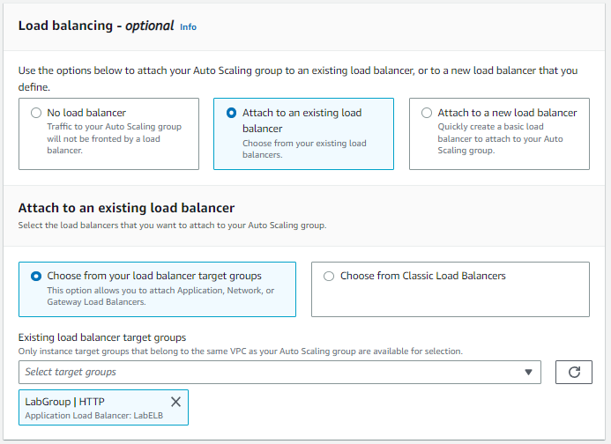
choose attach to an existing load balancer and then select labgroup from the dropdown

Slide 28
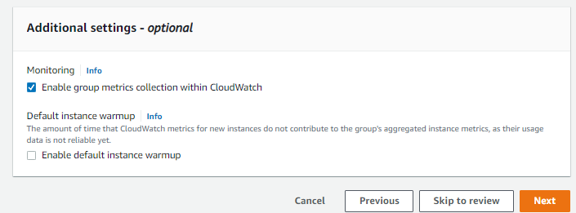
Enable group metrics collection within cloudwatch and click next

Slide 29
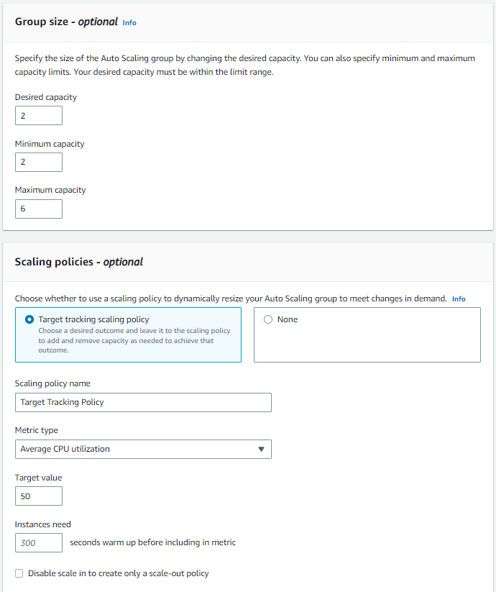
Set the settings as mentioned in the screenshot/labs and click next

Slide 30
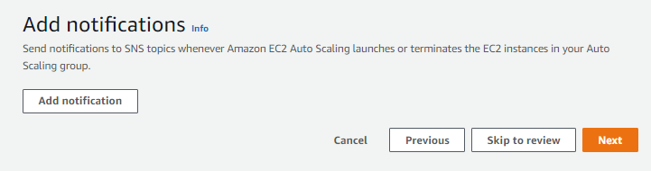
Click next

Slide 31
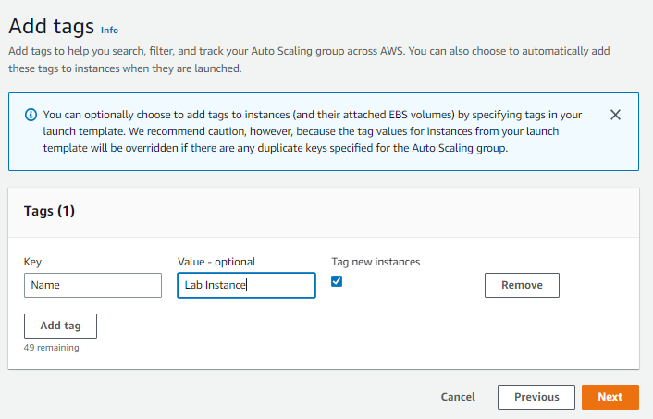
Add tags as shown and click next and then click create auto scaling group

Slide 32
Task 4: Verify that Load Balancing is Working

Slide 33
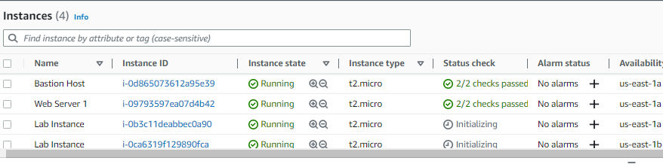
Click on instances in the left pane, YOU CAN SEE 2 NEW LAB INSTANCES ARE BEING CREATED

Slide 34
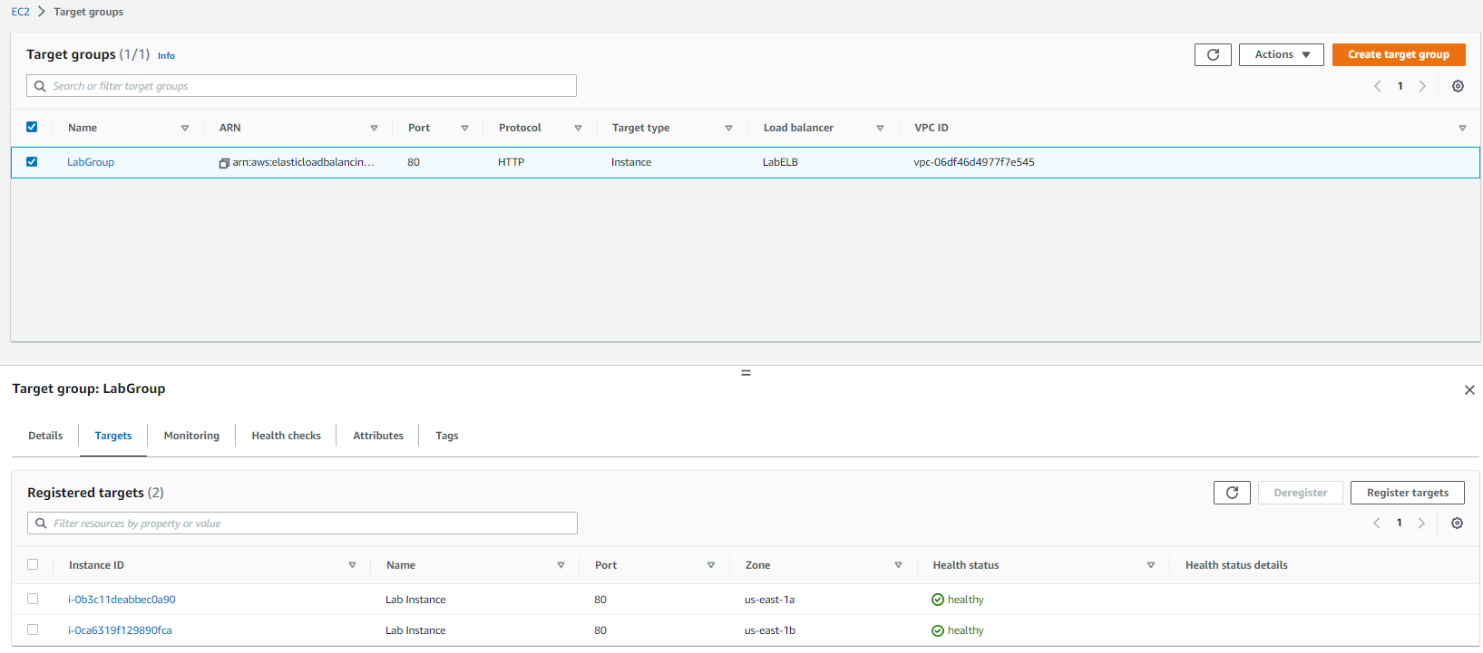
CHOOSE TARGET GROUP IN THE LEFT PANE AND THEN SELECT LABGROUP AND CLICK ON TARGETS AND THEN SEE IF THE TARGETS ARE HEALTHY

Slide 35
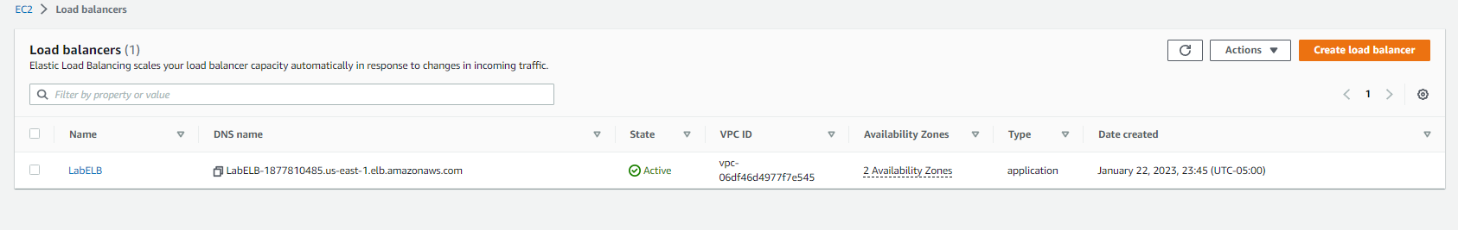
CLICK ON LOAD BALANCERS IN THE NAVIGATION PANE AND COPY THE DNS NAME

Slide 36
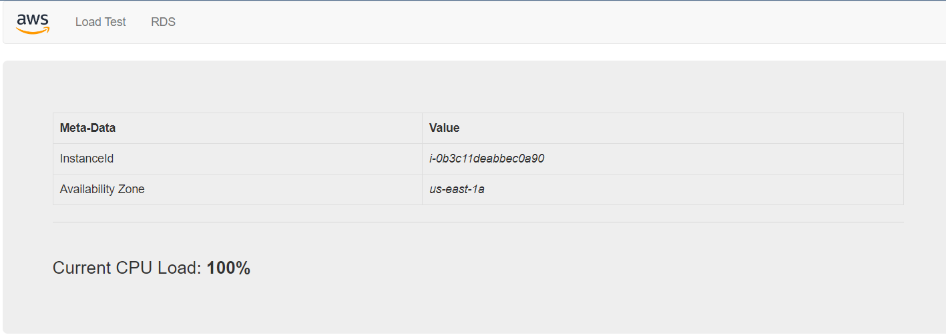
PASTE THE DNS NAME IN THE BROWSER

Slide 37
Task 5: Test Auto Scaling

Slide 38
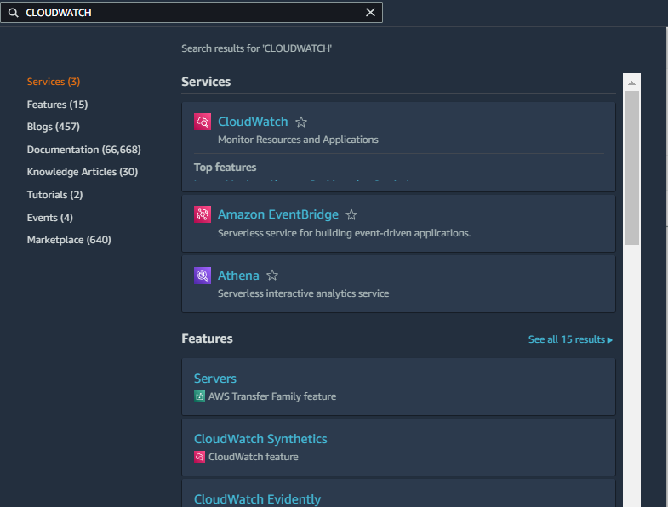
Search for cloudwatch in the search menu and click on cloudwatch

Slide 39
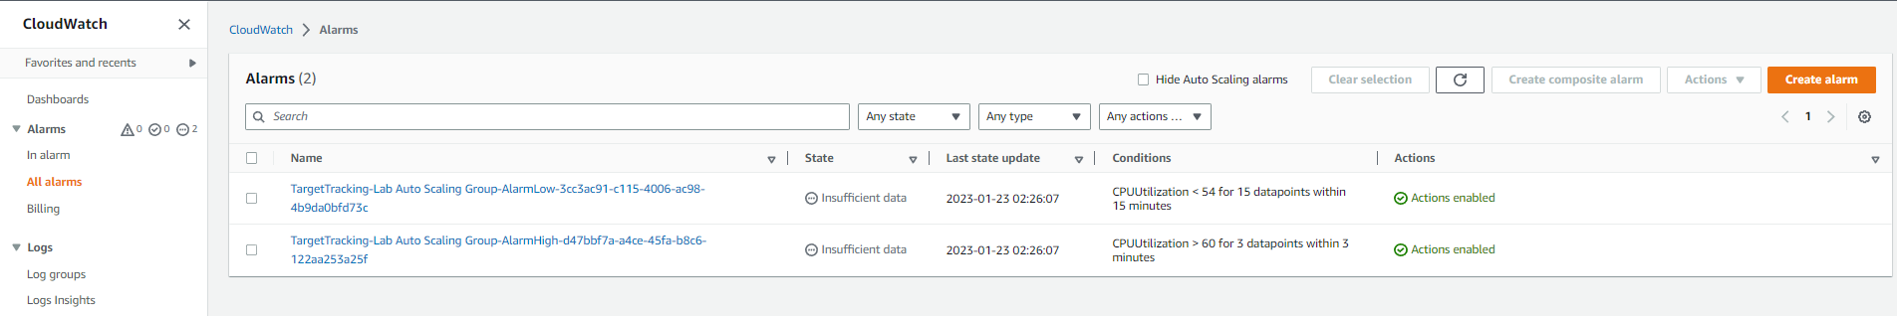
Click on all alarms to view the alarms in the Cloudwatch dashboard

Slide 40
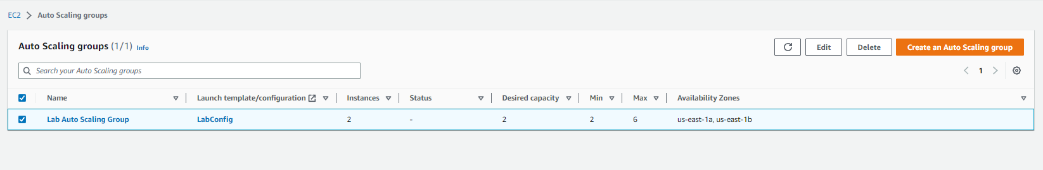
Note: in case you don’t see 2 alarms then, Go back to ec2 services page and click on load balancer in the navigation pane and select lab autoscaling group

Slide 41
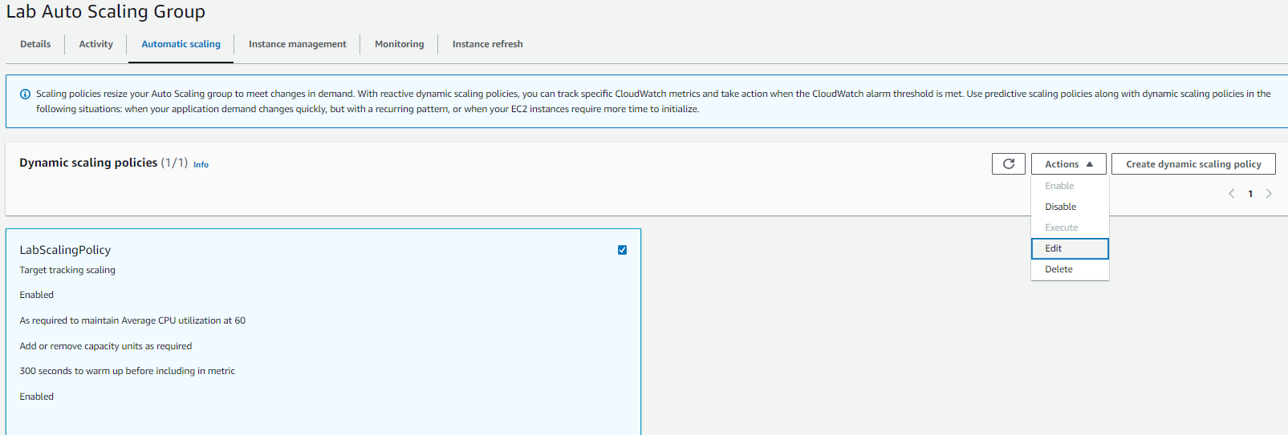
Note: in case you don’t see 2 alarms then, In the autoscaling tab click on labscalingpolicy and then action > edit

Slide 42
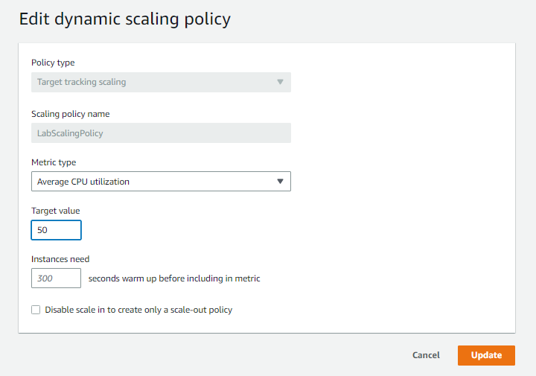
Note: in case you don’t see 2 alarms then, CHANGE TARGET VALUE TO 50 AND THEN HIT UPDATE

Slide 43
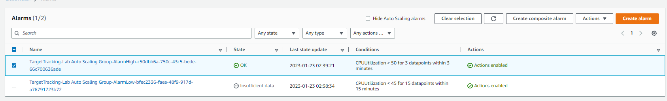
Click the ok alarm

Slide 44
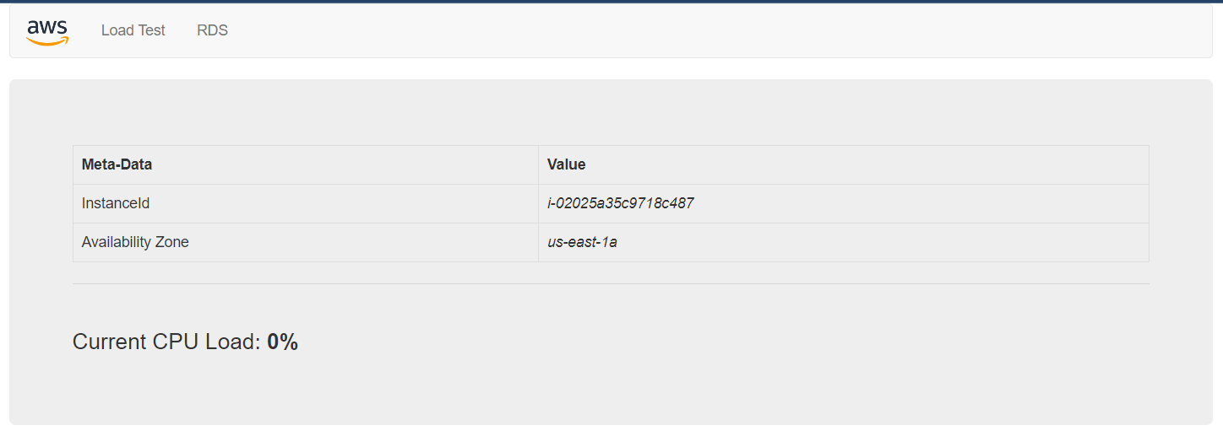
Go the browser tab and then click on load test

Slide 45
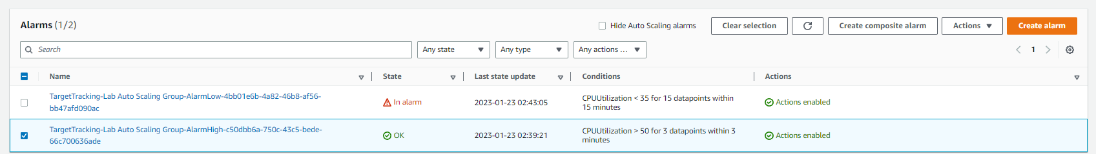
Return to cloudwatch tab, the alarm with low in its name’s state has changed to in alarm, the other alarm should also go to in alarm state

Slide 46
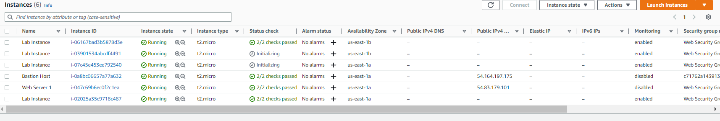
In the ec2 services, go to instance tab and you can see 2 more instances have been launched due to high load

Slide 47
Task 6: Terminate Web Server 1

Slide 48
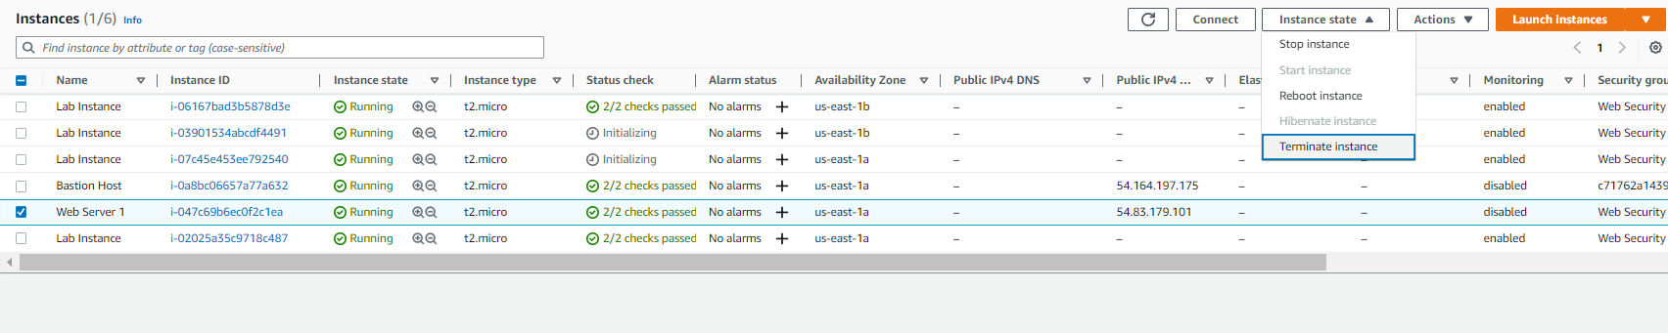
Under ec2 services go to instances and then select web server 1 instance state> terminate instance

Slide 49
THANK YOU
Amrit Singh

